Slide 1
Welcome
To
Transitional
Kindergarten
(TK)

Slide 2

Introductions
Mrs. Bannon- AM TK Teacher
Ms. Hawkins- PM TK Teacher
Mrs. Cruz- AM Classroom Aide
Mrs. Mendoza- PM Classroom Aide

Slide 3

What is Transitional Kindergarten?
This program is designed for students who will turn five between September 2nd and April 2^{nd.}
TK is the first year of a two year program.
We will be focusing on social and academic readiness in preparation for kindergarten.

Slide 4
Time
Morning TK - 7:50am to 11:10am (Monday – Friday)
Afternoon TK- 11:10am to 2:30pm (Tues.- 7:50am-11:10am)
Students will line up outside the Kindergarten Gate. A
teacher or staff member will open the gate to let students in.
It is very important to be on time

Slide 5
Safety
TK students will line up in front of their classrooms once the kindergarten gates are open. We are a closed campus. Parents will not be permitted to walk their student to class.
Children will be picked up at the kindergarten gate. Whoever picks up your child from school needs to check with their teacher before leaving.
Do not double park or call your child to come to the car.
Please bring and pick up your child on time!

Slide 6
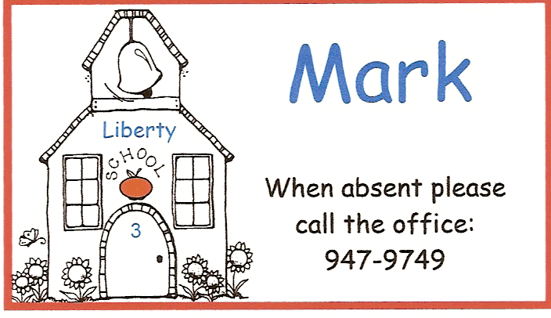
Absences
It is important to be at school everyday unless your child is sick.
Contact the office or send a note when your child is absent.
Missed work will be sent home, no need to return it.
Perfect attendance = no tardies.

Slide 7
Supplies
No backpacks please - papers will go home in their folders
Students may bring a lunch box. Small healthy snacks are recommended Water is the only beverage allowed for snack time. (fruit, string cheese, crackers or chips, small sandwich, yogurt) No Candy
Please write your child’s name on all personal items.
Students should not bring money or toys to school.
The school will provide paper, crayons, glue, etc.

Slide 8
General Information
Children should be able to fasten and unfasten their clothes by themselves.
We recommend closed-toed shoes for safety. No backless shoes are allowed.
Students may not wear hats in the classroom.
No tattoos.
Classroom parties will focus on healthy snacks. If you would like a copy of the official guidelines, please ask the office.
No Birthday Parties - We sing to the birthday child and they get to be line leader for the day. They will also get to
pick a story for our class to hear. They will get a small
treat from the teacher at the end of the day.

Slide 9
Typical TK Day
60 min. Whole group instruction
( Second Step, calendar activities, phonics, stories, songs, etc.)
20 min. Practice letters, numbers, shapes, etc.
30 min. Recess and snack time
60 min. Center Time – 4 fifteen minute groups with teacher,
and hopefully parent helpers.
* 20 min. Science/Social Studies/STEM
10 min. Whole group (review our day & explain homework)
Tuesday
We will have whole group instruction in the Maker’s Space along with
library time.

Slide 10
Homework
Homework is sent home Monday – Thursday.
Homework is for review and practice.
It is important to return it everyday.
Our homework will change as the year goes on.
School notes will be sent home in the homework folder.
Class work will be sent home on Mondays.
Please return homework daily, but keep other papers at home.
If your child needs help cutting, holding a pencil correctly, or tying shoes, please practice these skills at home.
Homework will start once students are comfortable with the classroom routine.

Slide 11
Report Cards
We are on the trimester system.
Report cards are based on the California State Standards.
Reports cards are done electronically in our district.
We will be conferencing with you the week of Sept. 19th.
At this time, we will discuss how your child is progressing both
socially and academically.
If you have any concerns, please call and leave a message or send a note and I will call you back.

Slide 12

Behavior Expectations
(Social-Emotional)
Our Social and Emotional Curriculum is Second Step. This program focuses on Social-Emotional skills, Problem Solving, Friendship, and Self Regulation.
Students are expected to come to school ready to learn.
Students will follow the classroom rules and be respectful to the teacher and other students.
Our classroom supports the “Clip System”. Students will start on green every day. Students can move their clip up for positive behaviors or down for negative behaviors.
Students that have a good day will receive a small reward at the end of the day for their awesome behavior and work habits.
We look forward to our classroom being a fun and exciting learning environment!

Slide 13

Fine and Gross Motor Skills
In TK we will be focusing on motor skills. We will be using strategies and manipulatives to improve motor skills.
Fine Motor Skills:
Holding a pencil correctly.
Cutting (Thumb up)
Lacing and Beading
Playdoh
Gross Motor Skills:
Running, Jumping and Skipping
Bouncing a ball to a friend
Riding Tricycles
Jumping Rope

Slide 14
School Website
Liberty has it’s own website with lots of information to keep our families informed.
You can access the class page, master calendar, see the lunch menu and pay online, view the current newsletter, get district information.
Our school website is - Liberty.chino.k12.ca.us
Teacher email- jodi_boonstra@chino.k12.ca.us
alisa_Hawkins@chino.k12.ca.us
Class Website- Please check it out. Lots of good
information. There is an Amazon “Wish List” for classroom donations. A link for this PowerPoint will also be on there.
Check it out !

Slide 15
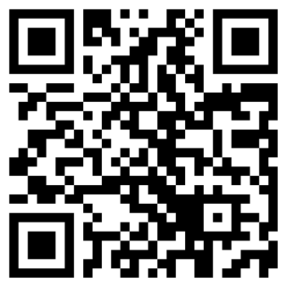
Mrs. Bannon’s - Remind 101
The safe Classroom Communication
Remind is a FREE communication tool that helps teachers connect instantly with parents through text messages or email.
These messages travel from teacher to parent. These are private messages. No other parents will be able to see your personal information. It is very safe and effective.
The purpose of remind is to provide parents with timely reminders of classroom events, assignments and other important information.
Take out phones, enter this number 81010 text message: @tk202320
https://www.remind.com/join/tk202320

Slide 16
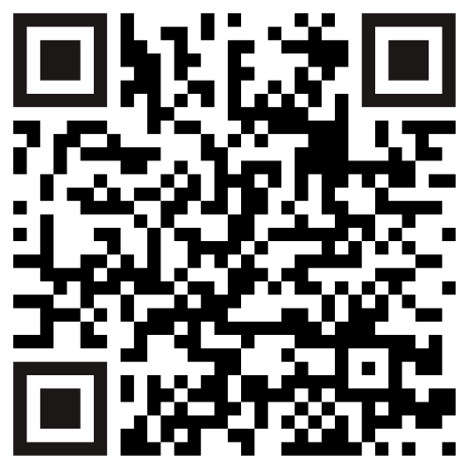
Ms. Hawkins’ ClassDojo
This is another form of communication for the PM Class. It is called ClassDojo. Please use the QR Code to sign up.
We send out a lot of important information. Please ensure that this is completed.

Slide 17


TK BUSINESS
PLEASE JOIN OUR PTO!! The Parent/Teacher Organization is a great way to support our school. They help us pay for our field trips and many other school events.
The cost is $10 per student to join or $15 for the entire family.
We are doing some fun incentives for students who join!
All classes to get 100% will earn a pizza party
All Parents are welcome to join the PTO. Meetings are the 2nd Wednesday of the month at 2:40pm. The first meeting is 8/10.
Please wear your Liberty School T-Shirts every Friday! They can be purchased in the office.

Slide 18

It’s going to be a great year in TK!
Mrs. Bannon & Ms. Hawkins
909-947-9749 Rm. 3
Jodi_Boonstra@chino.k12.ca.us
Alisa_Hawkins@chino.k12.ca.us

